Slide 1

Customer Satisfaction
Presented by: Carlos Reyes Last update: 2020

Slide 2
Table of Contents
Introduction
Objectives
Analysis
Observations

Slide 3
Introduction

Slide 4
Introduction
A recent analysis was made regarding our customer support team’s performance during the month of October.
The operations manager noticed that this analysis did not include any information regarding the customer satisfaction surveys.
This metric is a key indicator of the business’s health and how well the service is resonating with our customers.

Slide 5
Objectives

Slide 6
Objectives
Conduct an analysis focused on the customer satisfaction scores.
Compare customer satisfaction with the rest of the metrics to find any patterns or outliers.

Slide 7
Analysis

Slide 8
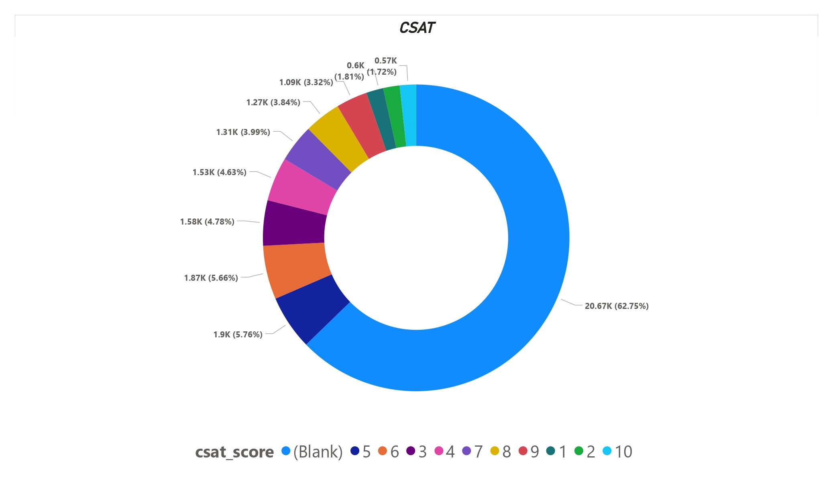
CSAT (Customer Satisfaction)
1 to 5 reflect a negative experience.
6 & 7 reflect a neutral experience.
8 to 10 reflect a positive experience.
In almost 63% of the interactions the customers did not answer the survey.

Slide 9
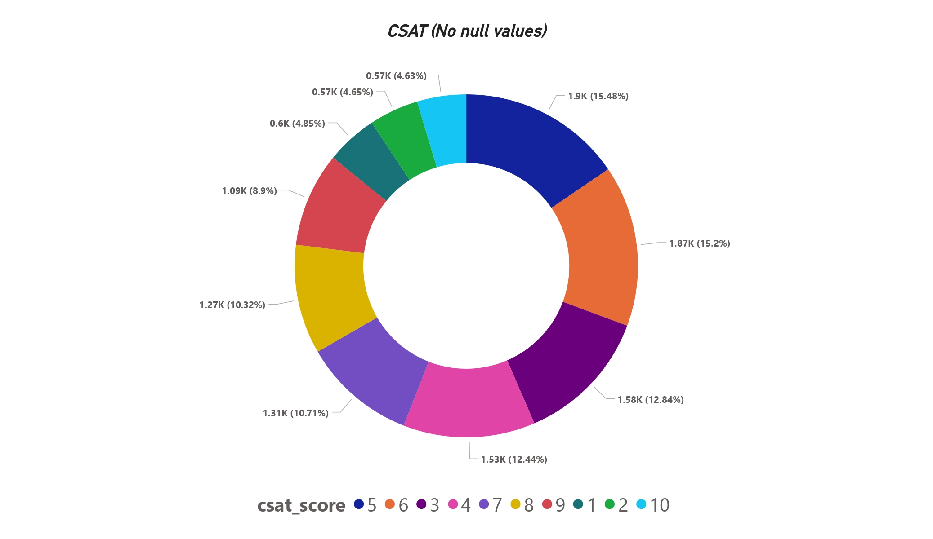
CSAT (w/o null values)
The number of positive surveys sums up to approximately 2,930 (24%).
The number of neutral surveys sums up to approximately 3,180 (26%).
The number of negative surveys sums up to approximately 6,180 (50%).

Slide 10
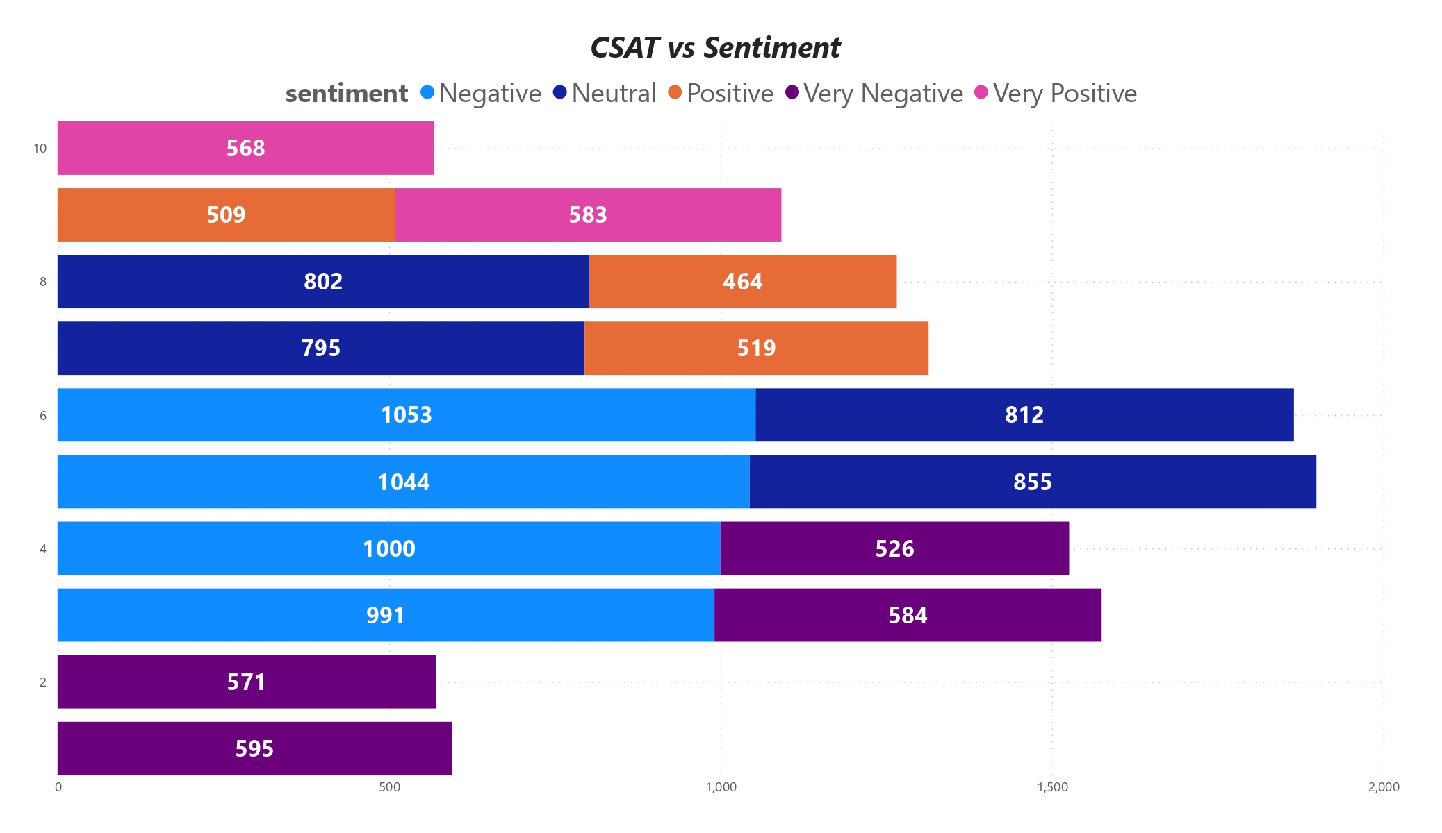
CSAT vs Sentiment
Calls with positive and very positive sentiment tend to have higher scores.
Calls with neutral, negative and very negative sentiment tend to have lower scores.
Sentiment during the interaction impacts the customer satisfaction directly.

Slide 11
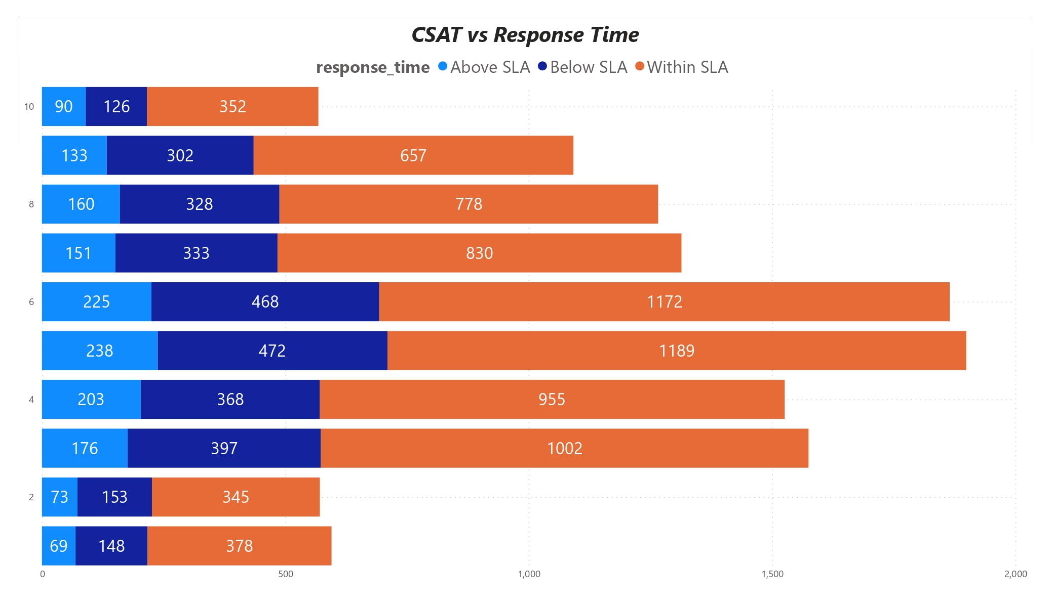
CSAT vs Response Time
Most of the calls were answered within the set time frame.
There is no direct relationship between response time and customer satisfaction.

Slide 12
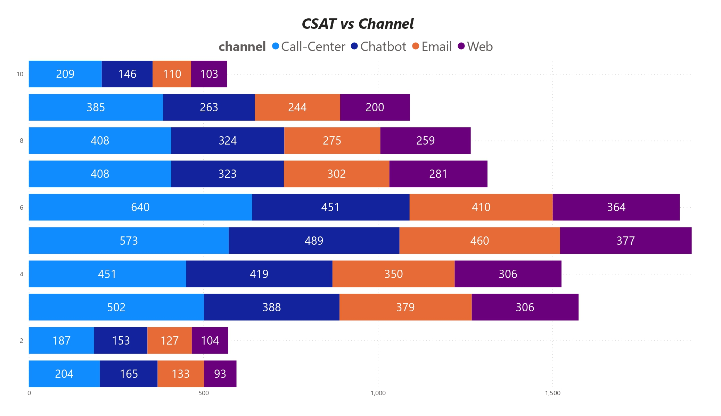
CSAT vs Channel
Call center is the preferred contact channel for customers.
Further analysis needed to determine if the contact channel affects customer satisfaction.

Slide 13
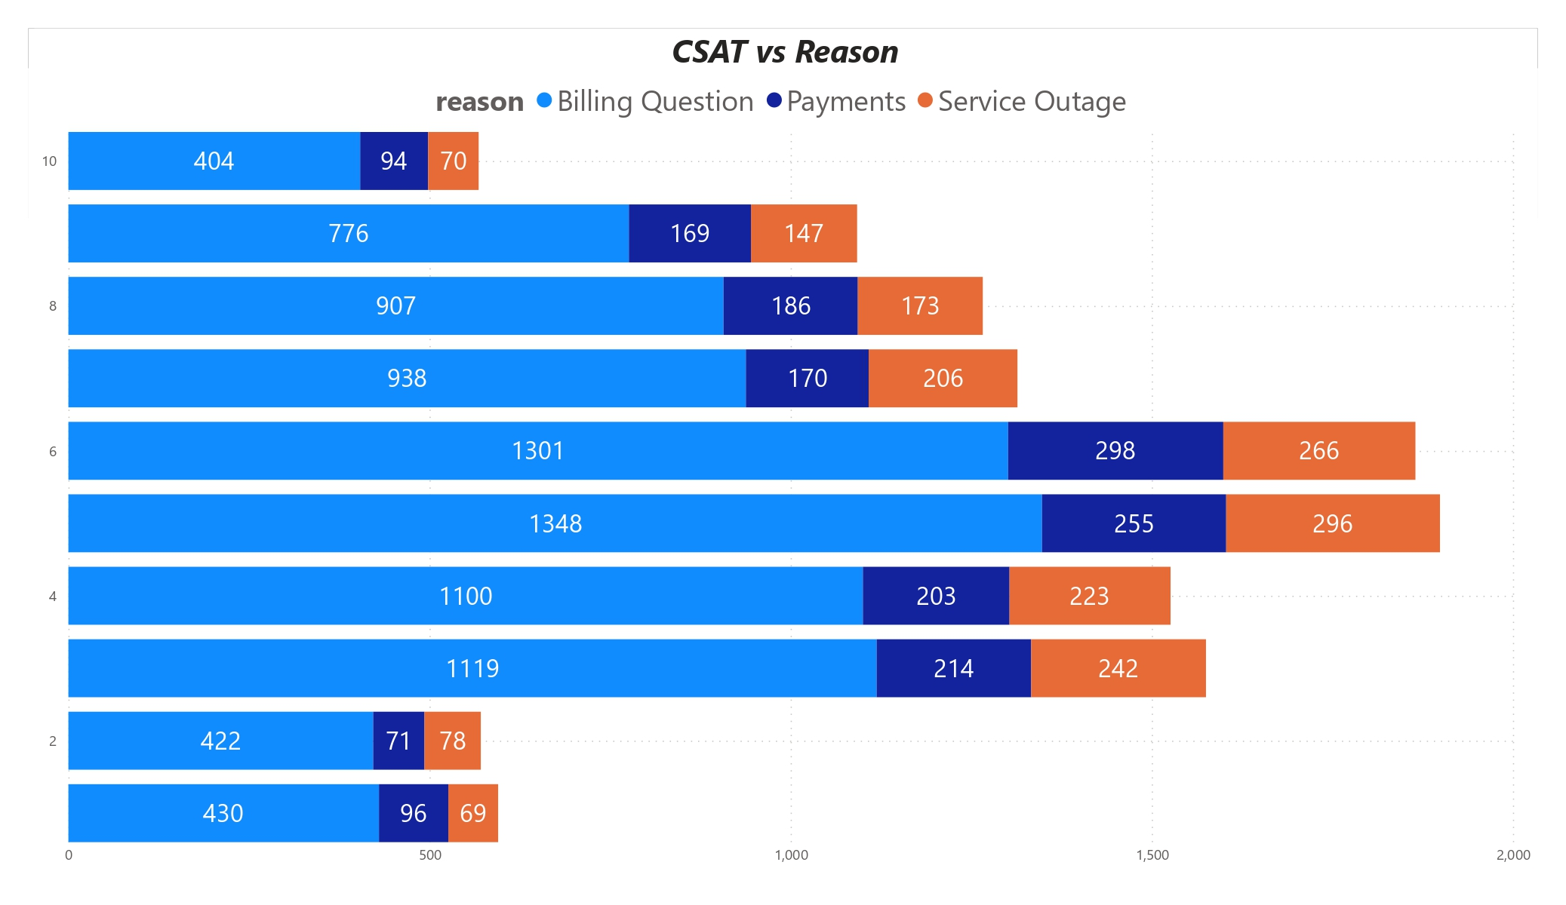
CSAT vs Reason
Billing questions is the main reason why customers decide to contact us.
There is little to no relationship between customer satisfaction and the reason of the interaction.

Slide 14
Observations

Slide 15
Observations
Customers are not being motivated to answer the survey at the end of the interactions.
Over 70% of the customers that answered the survey had a negative or neutral experience.
Sentiment is the only metric that has a direct impact in customer satisfaction. Nevertheless, further analysis and investigation is recommended to determine any relationship with the other metrics.
Even though there was no direct impact found, handling billing interactions should be reinforced to provide the best customer experience possible.

Slide 16
Thank you for your attention

